Slide 1
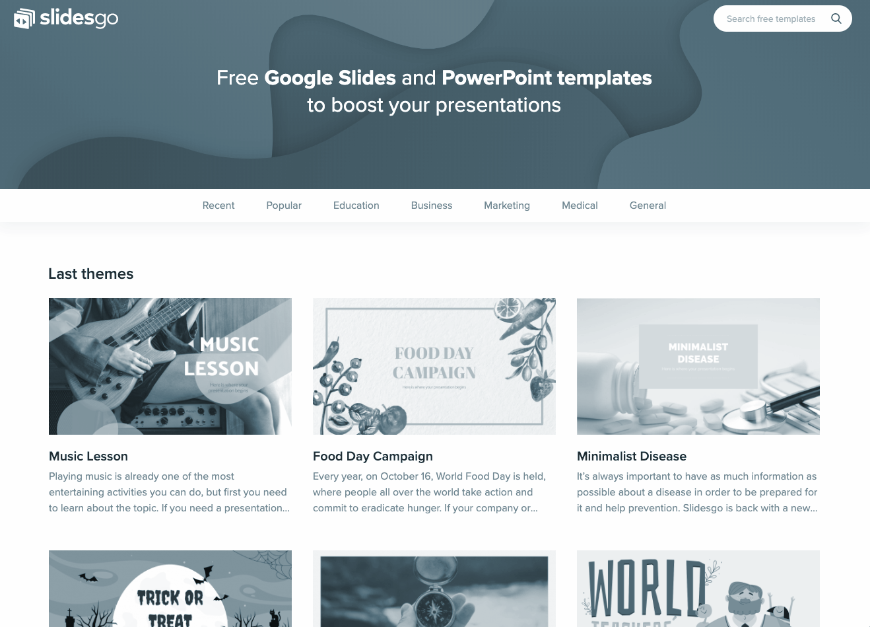
Automating Recruiting Workflow to Hire Candidates

Slide 2
Supervisor
Co-Supervisor
Muhammad Irzam
Miss Farheen Ramzan

Slide 3

Team Structure

Slide 4




01
02
2018-CS-31
2018-CS-14
03
04
2018-CS-04
2018-CS-32
Ghulam Ghous (Team Lead)
Muhammad Faisal
Ahmad Bilal
Ahmad Zaheer

Slide 5

Introduction

Slide 6
Overview
ML enabled automated hiring process.
Candidate Filtering using Resume Parsing (NLP)
Analysis of video interview:
Soft Skills Analysis (CVIP) [1]
Technical Skills Assessment (NLP)[6]

Slide 7
Motivation
COVID-19
Automated Hiring
Best candidates will be hired
No biasedness
Fast and user friendly

Slide 8
Problem Statement

Slide 9
Problem Statement
Our aim is to build an intelligent solution that will automate the hiring process by filtering out worthy candidates and assessing their technical and communication abilities.

Slide 10
Competitive Analysis
A summary of comparison between similar projects and their benefits .

Slide 11


Competitive Analysis
 | Resume Parsing | Automated initial Test | Soft Skills Assessment | Technical Skills Assessment
Interviewer.ai [2]
TestGorilla [3]
Ideal [4]
hirestream [5]
Lytmus [6]
Hire-o-Bot

Slide 12
Scope

Slide 13
Scope
Video Interview (Using CVIP & NLP)
Soft skills analysis - Confidence Attribute [1]
Technical skills assessment - Relevance to the correct answer [6]
Resume parsing
Using tokenization and stop word filtering [6]
PDF input
Questionnaire Tests
Notes:
https://pypi.org/project/resume-parser/

Slide 14
Methodology

Slide 15
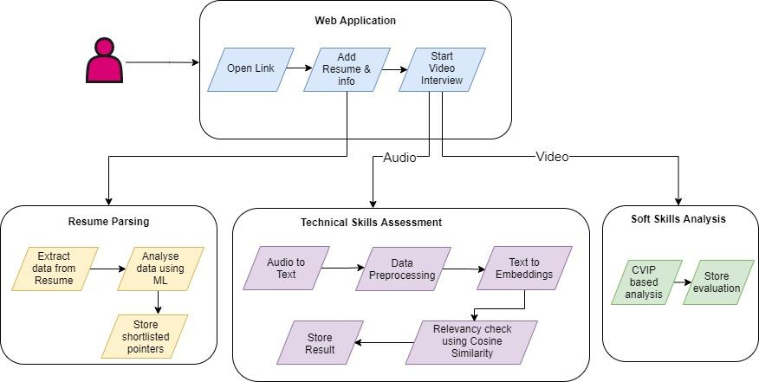

Slide 16

Challenges & Limitation

Slide 17

Challenges
Accuracy
Security
Observance of Soft Skills
Data Acquaintance
Dialectal Difference

Slide 18

Limitations
Language
Domain Specific
Error Dependency
Bandwidth

Slide 19
Timeline

Slide 20
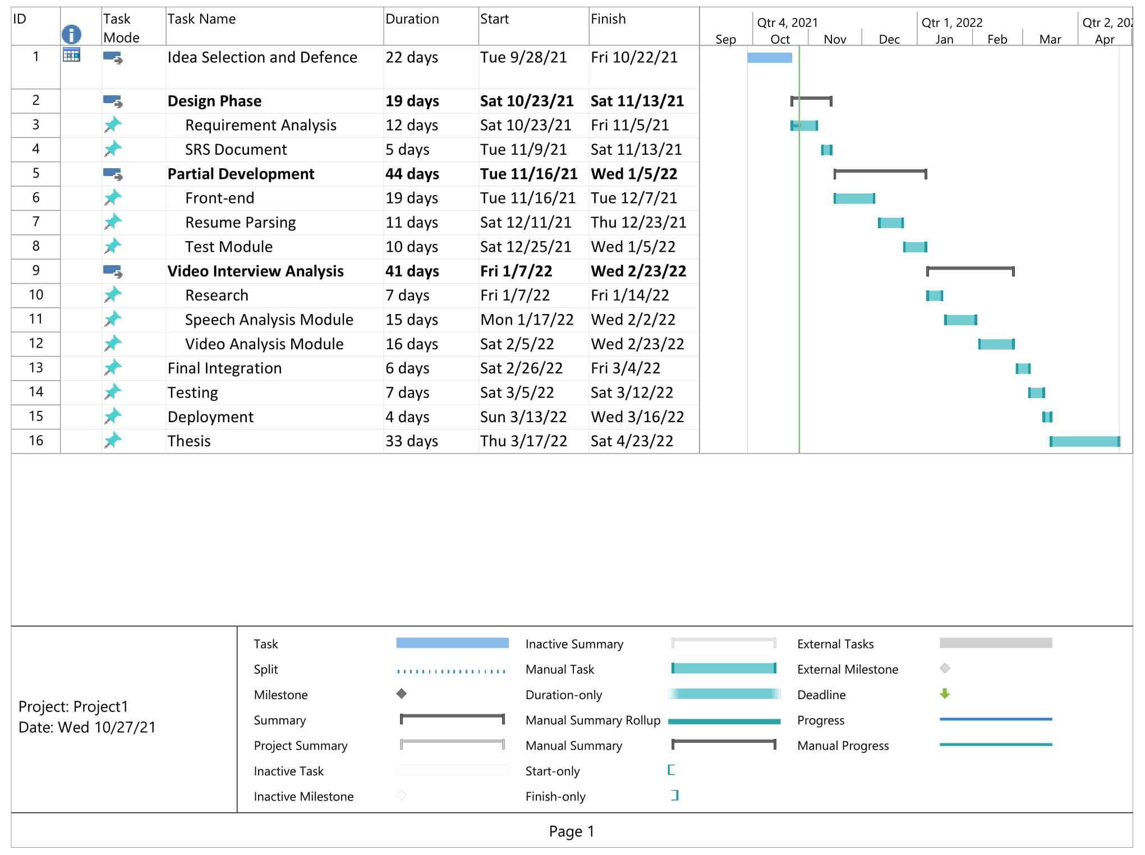

Slide 21
References

Slide 22
[1] Kral, P., & Lenc, L. (2014, March). Confidence Measure. ResearchGate. Retrieved October 2021, from https://www.researchgate.net/publication/263582245_A_Composed_Confidence_Measure_for_Automatic_Face_Recognition_in_Uncontrolled_Environment
[2] Interviewer.AI. (2018, November 7). Interviewer.AI | #1 End-to-End AI Video Interview Platform. Retrieved October 10, 2021, from https://interviewer.ai/
[3] TestGorilla. (2019). Pre-Employment Screening Tests and Assessments. Retrieved October 14, 2021, from https://www.testgorilla.com/
[4] Folick, O. (2019, June 30). Ideal Announces New Patent For Its AI For Recruiting Technology. Ideal. Retrieved September 14, 2021, from https://ideal.com/ideal-patent-determining-best-candidates/
[5] Hirestream. (2021). Hirestream.Io. Retrieved October 15, 2021, from https://hirestream.io/
[6] Neto, J. (2021, May 27). Best NLP Algorithms to get Document Similarity - Analytics Vidhya. Medium. Retrieved October 14, 2021, from https://medium.com/analytics-vidhya/best-nlp-algorithms-to-get-document-similarity-a5559244b23b
[7] Lytmus – Hire using real tasks, not brainteasers · Web, Ops, QA, Data. (2013). Lytmus. Retrieved October 14, 2021, from http://www.lytmus.com/

Slide 23
Thank you!
Do you have any questions?

